Slide 1
CSP 571- DATA PREPARATION AND ANALYSIS
Fall 2023
Department of Computer Science
TOPIC: PLAYER PERFORMANCE ANALYSIS
Done by,
Aditya Shivakumar - A20513527
Punalraj Parthasarathy- A20519421
Chenglong Wu Yang - A20518979

Slide 2
PROJECT PLAN
Problem Statement
Dataset Description
Data Handling
Exploratory Data Analysis
Correlation Analysis
Performance Metrics
Model Selection and Evaluation for Predicting Player Position
Conclusion

Slide 3
PROBLEM STATEMENT
Development and implementation of an analytical framework for analyzing extensive football player data.
Identification of key performance indicators and categorization of players by positions and continents.
Utilization of exploratory data analysis and visualization techniques for deriving meaningful insights.
Employment of predictive models to forecast player performance metrics and positions.

Slide 4
DATASET DESCRIPTION
The dataset, sourced from Kaggle, encompasses detailed 2022-2023 football player statistics per 90 minutes, spanning five major leagues: Premier League, League 1, Bundesliga, Serie A, and La Liga.
The dataset contains:
2,500 rows
124 columns
The dataset column contains:
Personal information
In-game metrics
Advanced analytics

Slide 5

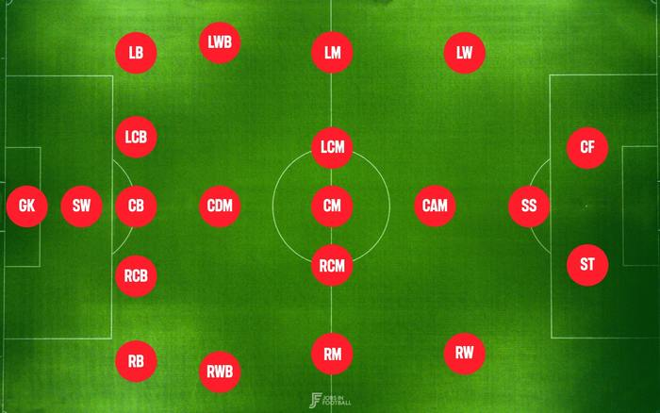
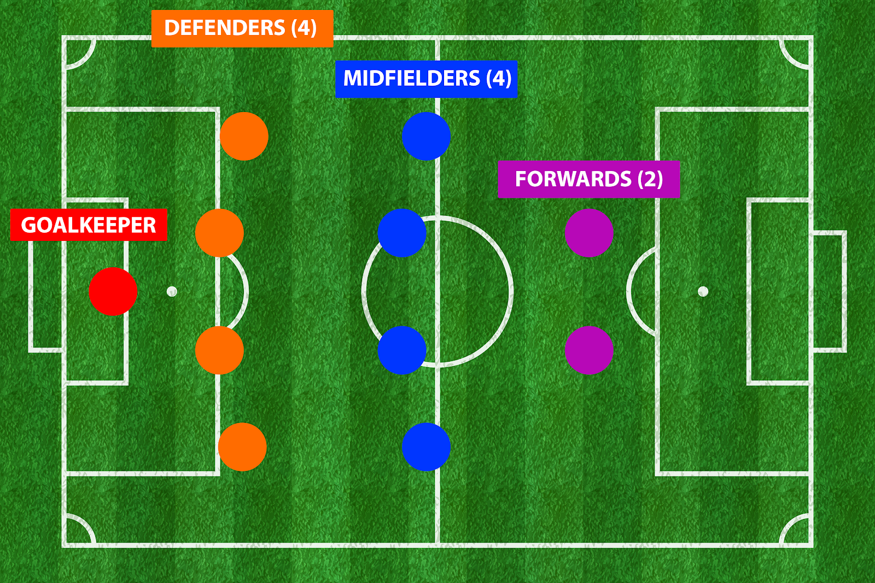
DATA HANDLING
Missing values across the dataset were checked; it was decided to replace any missing values with zero to avoid distorting data, based on the context of football player statistics.
Duplicate rows were identified and removed to maintain data integrity and accuracy for analysis.
An 'Age Group' column was introduced, revealing that most players are under 25, indicating the sport's preference for youth due to its physical demands.

Slide 6
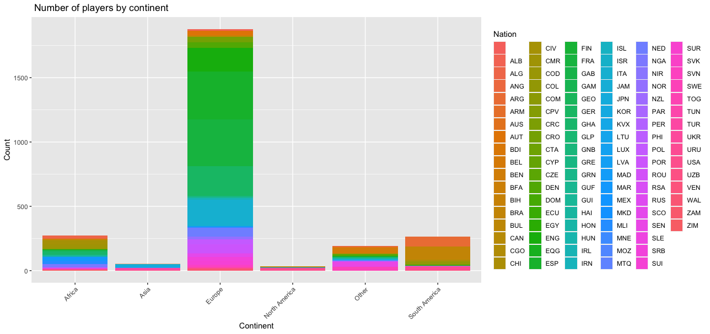
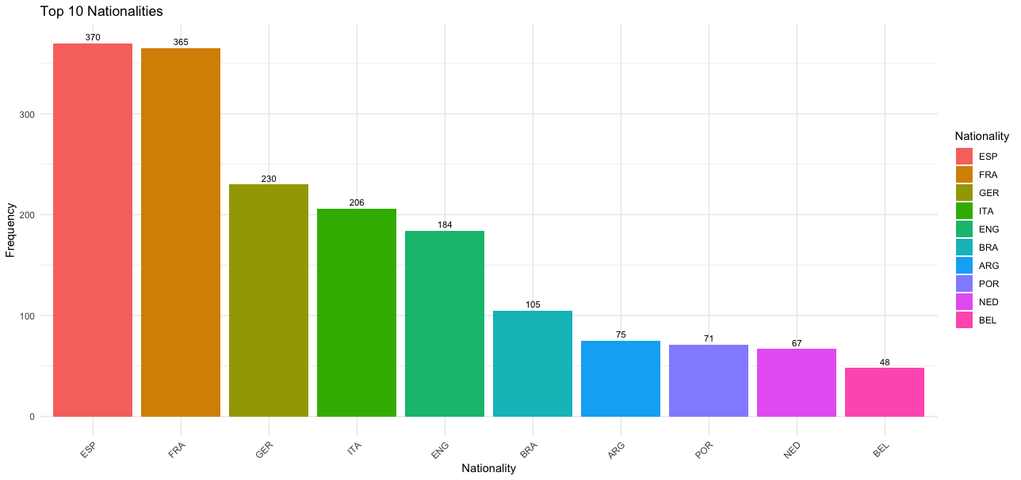
Plot For Number Of Players Vs Continents and their nationality
The graph suggests a dominance of European players, likely due to the dataset's focus on Europe-based leagues.
The data distribution represents a strong presence of European nationalities, particularly from Spain and France.
This trend might be influenced by factors such as national league popularity, player familiarity, and regional football traditions.

Slide 7
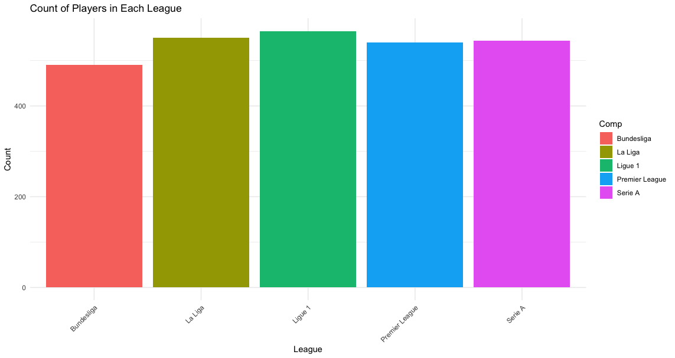
Plot For Count Of Players in each Major League
In the given plot we can see the amount of players in the 5 Major Leagues.
Bundesliga
La Liga
Ligue 1
Premier League
Serie A

Slide 8
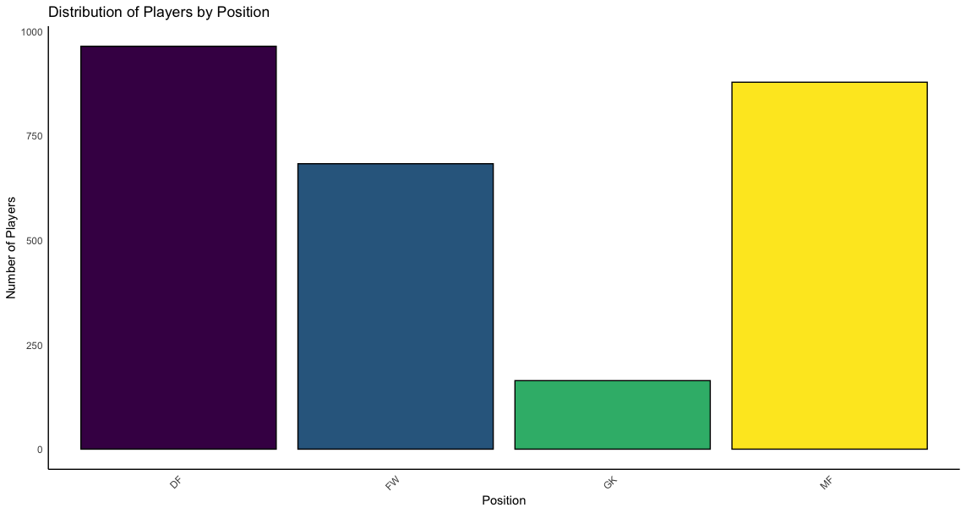
DISTRIBUTION OF PLAYERS BY POSITION
The dataset reveals that Defenders (DF) are the most prevalent group.
Following closely are Midfielders (MF) and Forwards (FW), with Goalkeepers (GK) being the least represented.
This reflects typical player composition in a football team, where a larger number of defenders and midfielders is often required.

Slide 9
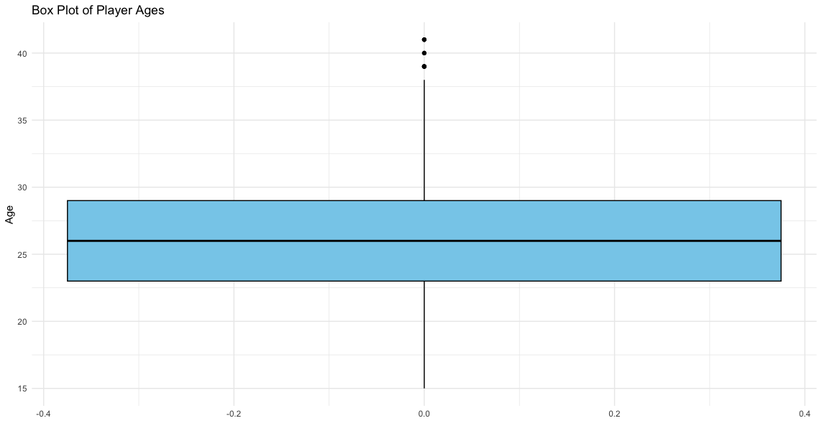
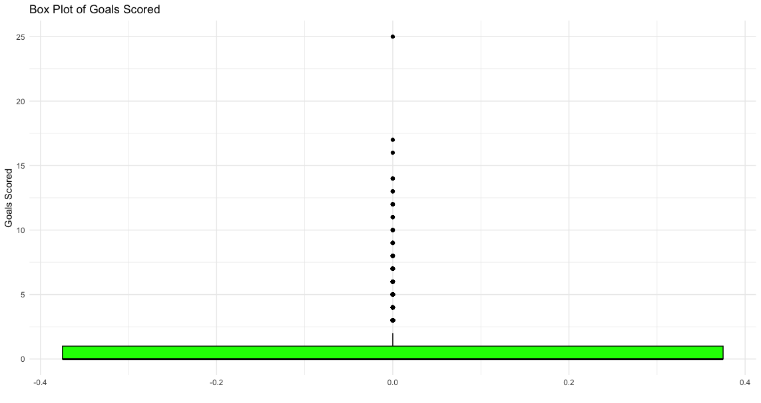
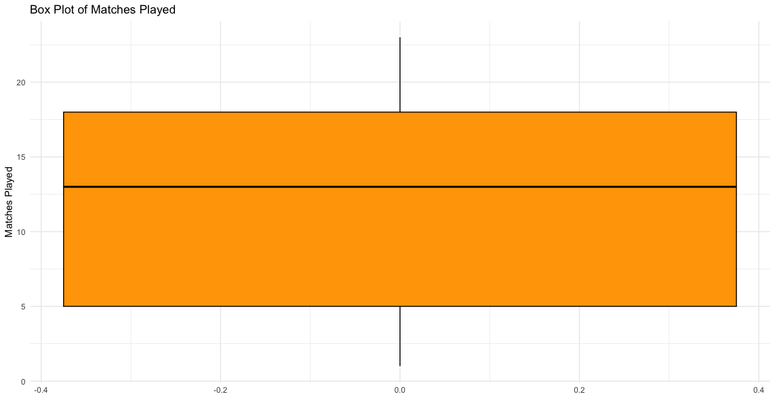
BOX PLOT TO CHECK FOR OUTLIERS
Box plot of players age
Box Plot of matches played
Box Plot of goals scored
The (left side) box plot depicts a concentration of participants in their mid-to-late twenties, with outliers reaching their forties.
The (center) box plot indicates that most players participate in a moderate number of matches, with only a few engaging in exceptionally high or low counts.
In the (right side) box plot, the concentration toward the lower end of the plot shows that most players score only a few goals, while a significant number of outliers highlight exceptional goal scorers.

Slide 10
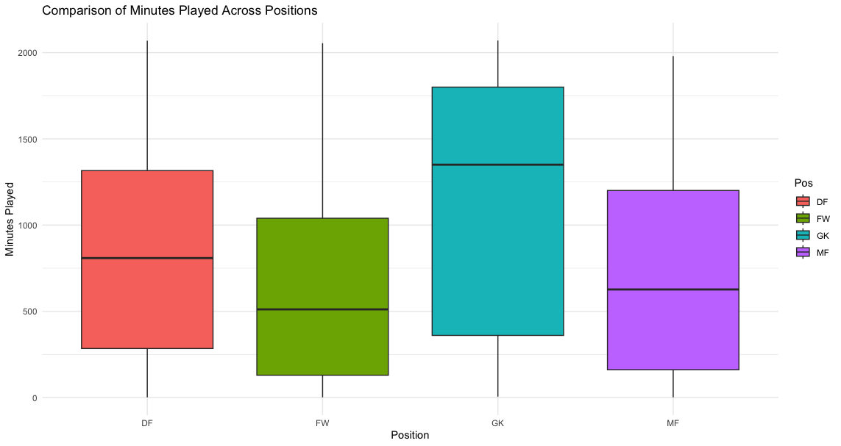
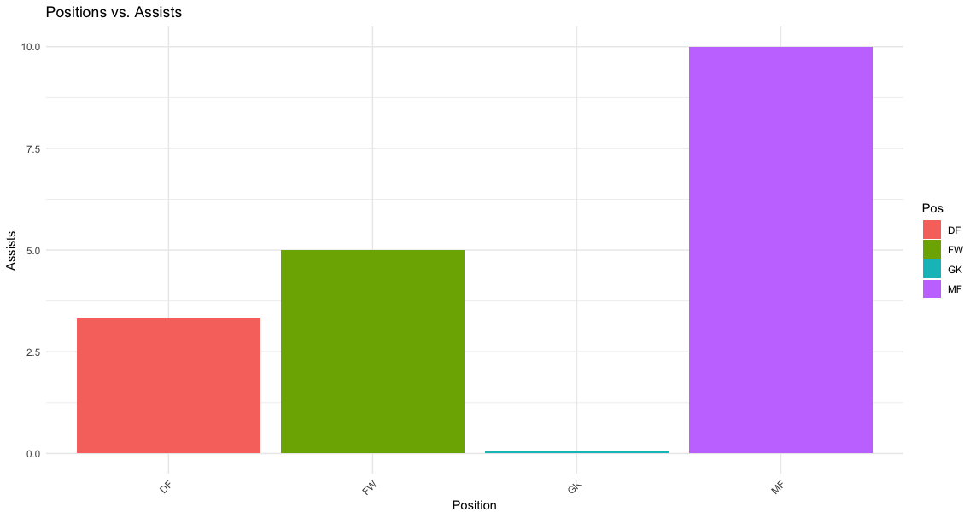
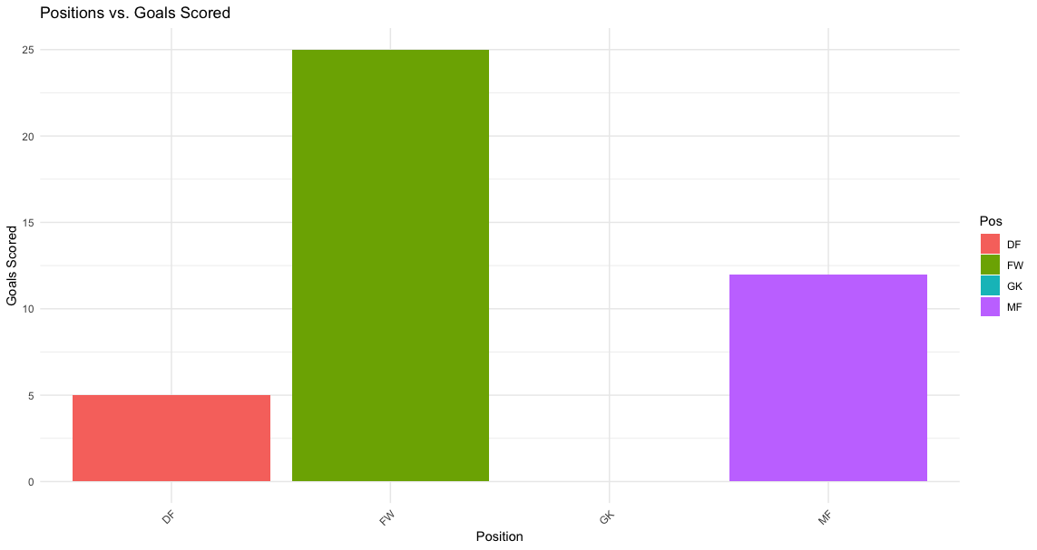
Left Upper Side: Plot shows a comparison between each different position and their minutes played.
Left Bottom Side: Plot shows a comparison between each different position and goals scored.
Right side: Plot shows a comparison between each different position and assist done.

Slide 11
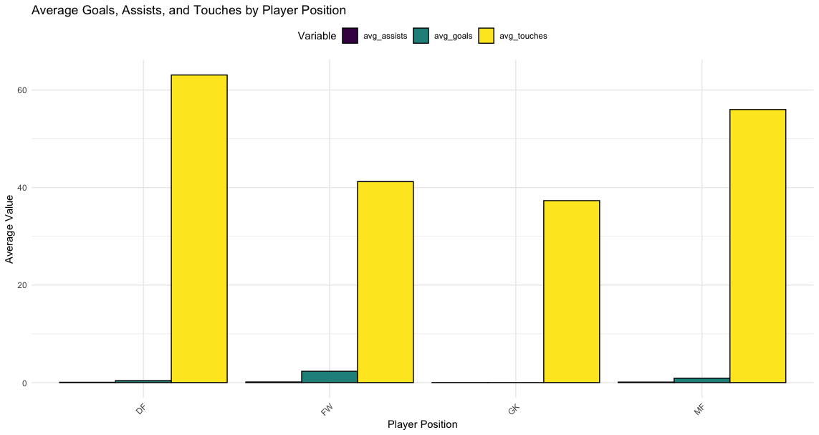
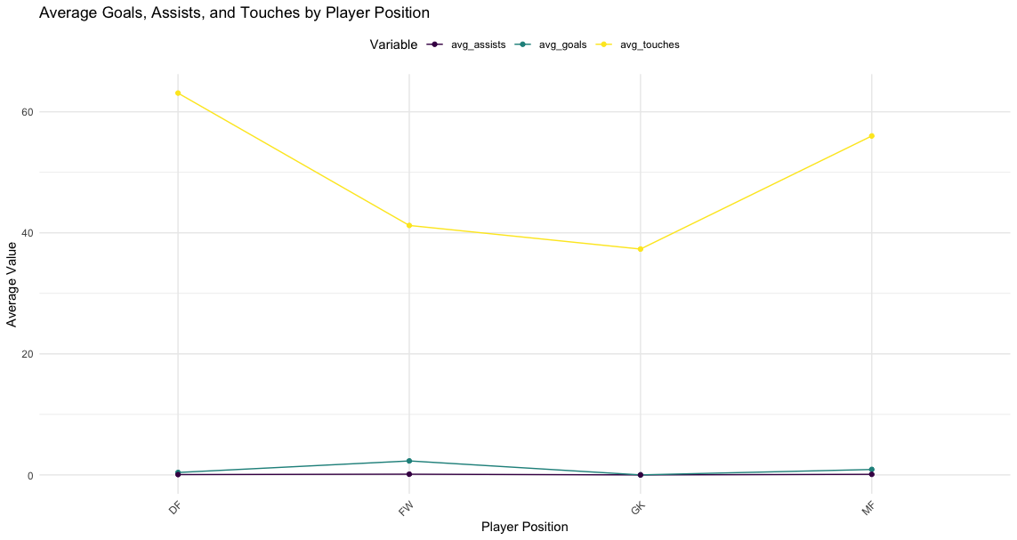
Plot of Average Goals, Assist and Touches Per Position
Midfielders (MF) have the highest average values for assists and touches, which is consistent with their role in game control and opportunity creation. Forwards (FW) have a high average amount of goals, which corresponds to their primary goal of scoring.
Defenders (DF) Goalkeepers (GK) have low goal and assist statistics, which is to be anticipated considering their defensive positions. When compared to midfielders, their average number of touches is similarly smaller, indicating less frequent involvement in ball possession.

Slide 12
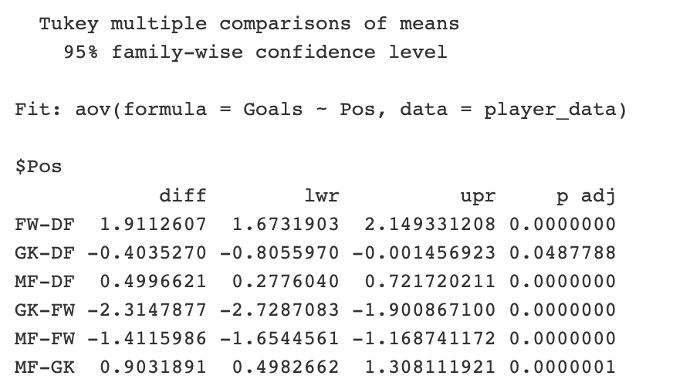
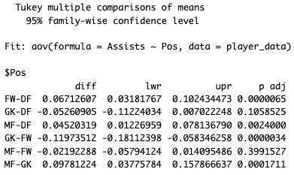
Tukey HSD is used to determine exactly which positions differ from each other after finding a significant F-statistic from the ANOVA.

Slide 13
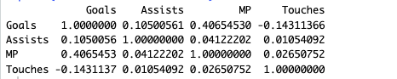
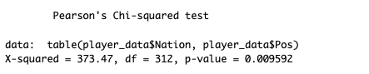
Goals vs. Assists: Slight positive correlation (r = 0.11); more goals scored marginally increase assists.
Goals vs. MP: Moderate positive correlation (r = 0.41); more matches played typically lead to more goals.
Goals vs. Touches: Weak negative correlation (r = -0.14); more ball touches don't necessarily lead to more goals.
Assists vs. MP: Moderate positive correlation (r = 0.41); players with more assists tend to play more matches.
Assists vs. Touches: No significant correlation (r = 0.01); touches don't predict assists.
Touches vs. MP: Very weak positive correlation (r = 0.03); match play has minimal impact on touches.
The test results indicate that player positions in the dataset are not distributed irrespective of nationality. various positions may be more or less prevalent among various ethnicities, indicating probable cultural or training differences in the sport among countries.

Slide 14
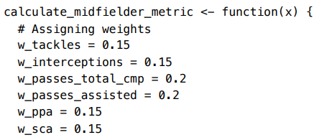
PERFORMANCE METRICS
The performance metrics are calculated by considering the player's position and assigning weighted importance to features specific to that role.
The code provided illustrates the differential weighting assigned to various features, tailored to each position.
Additionally, the features incorporated into the player performance metrics vary across positions, as they are selected through manual analysis to include key attributes that are most relevant for each specific role on the field.
.
An example of performance metric weight assignment

Slide 15
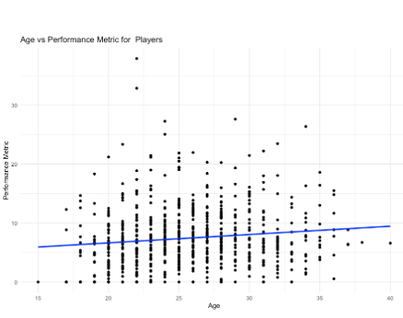
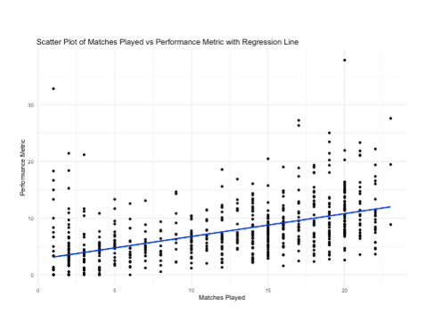
PERFORMANCE METRICS
In the left side plot suggests that there is a statistically significant relationship between age and the performance metric for players. Given the low R-squared values, age alone does not strongly predict the performance metric.
The positive slope of the regression line in the scatter plot shows that as players participate in more matches, their performance metric tends to increase.

Slide 16
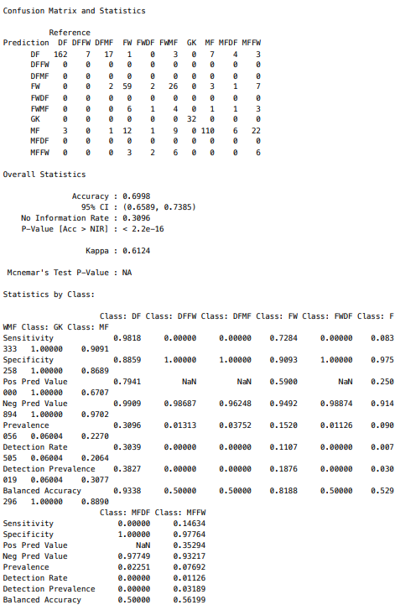
Model summary for Random forest model
PCA has been implemented on the dataset to select only the important features.
The confusion matrix indicates the performance of the model has an overall accuracy of 69.98%.
This accuracy is significantly better than random chance, as suggested by the p-value of less than 2.2e-16.
The Kappa statistic of 0.6124 further indicates a substantial agreement between the predicted and actual classifications, correcting for chance.

Slide 17
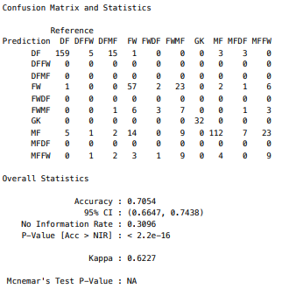
Model summary for SVM model
The classification model exhibits an overall accuracy of 70.54%, with a substantial Kappa statistic of 0.6227, indicating significant agreement beyond chance.
The model demonstrates strong predictive performance for classes like "DF" and "GK," achieving high sensitivity and specificity.
However, challenges are observed in correctly identifying instances of certain classes, such as "DFFW" and "FWMF," where sensitivity is notably low.

Slide 18
CONCLUSION
This project's extensive data analysis on football player statistics meticulously prepared the dataset for analysis, uncovering key positional features and the impact of age and matches played on player performance.
The exploration revealed distinct patterns in player distribution and led to the development of a unique 'performance metric', quantifying each player's performance based on their statistical data.
Predictive models, including Random Forest and SVM, were employed, achieving commendable accuracy. However, the imbalance within the dataset indicates the need for alternative methods to achieve a more balanced analysis.
The study uncovered a positive correlation between age and matches played, suggesting that increased experience enhances performance. It also highlighted a preference for European players and those in their prime age, shedding light on recruitment trends in professional football management.

